Slide 1

By Akash Kumar Vinodiya
Business Analyst Career Program - Capstone Project

Slide 2

Agenda
Data Exploration
Statistical Analysis using Excel
Graphical Analysis using Excel
Insert the given data into the SQL server
Import the Data from the SQL Database into PowerBI
Interactive Dashboard by using visualization tools
Conclusion and Inferences
Endnotes

Slide 3
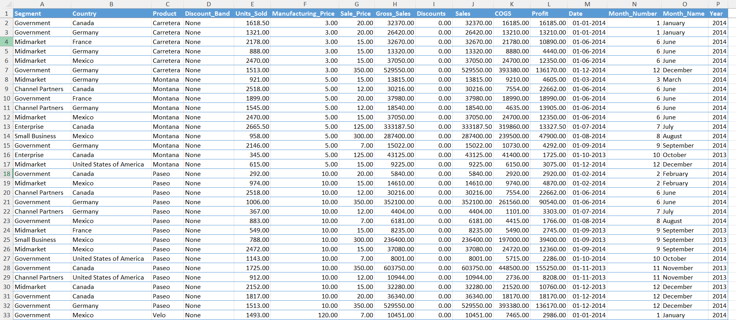
Data Exploration
The dataset contains 700 records and 16 columns, representing financial data for various products sold in Western countries.
Key attributes include Segment, Country, Product, Discount Band, Units Sold, Gross Sales, Discounts, Profit, and time-related fields like Date, Month Name, and Year.
Products are categorized across five segments and sold in five countries, with attributes detailing their pricing, sales performance, and profitability.
The Units Sold range from 200 to 4492.5, with gross sales peaking at $1,207,500 and discounts varying significantly.
The data spans from September 2013 to December 2014, allowing for time-series and segment-based analysis of sales trends and profitability.

Slide 4
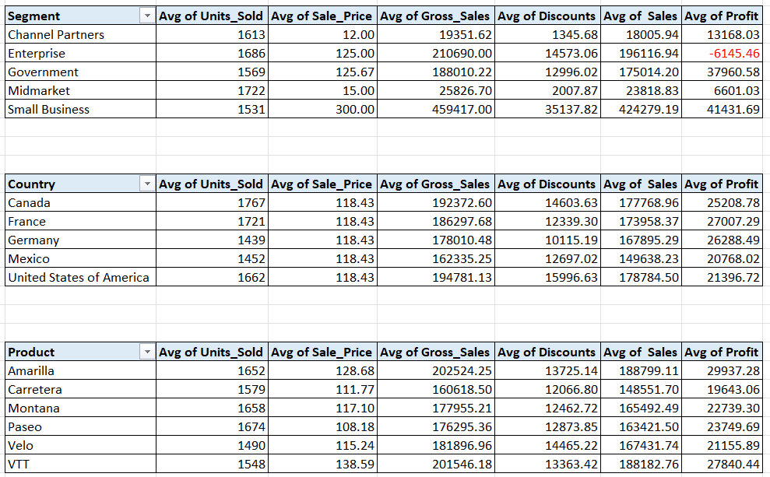
Statistical Analysis using Excel

Slide 5
Graphical Analysis using Excel

Slide 6
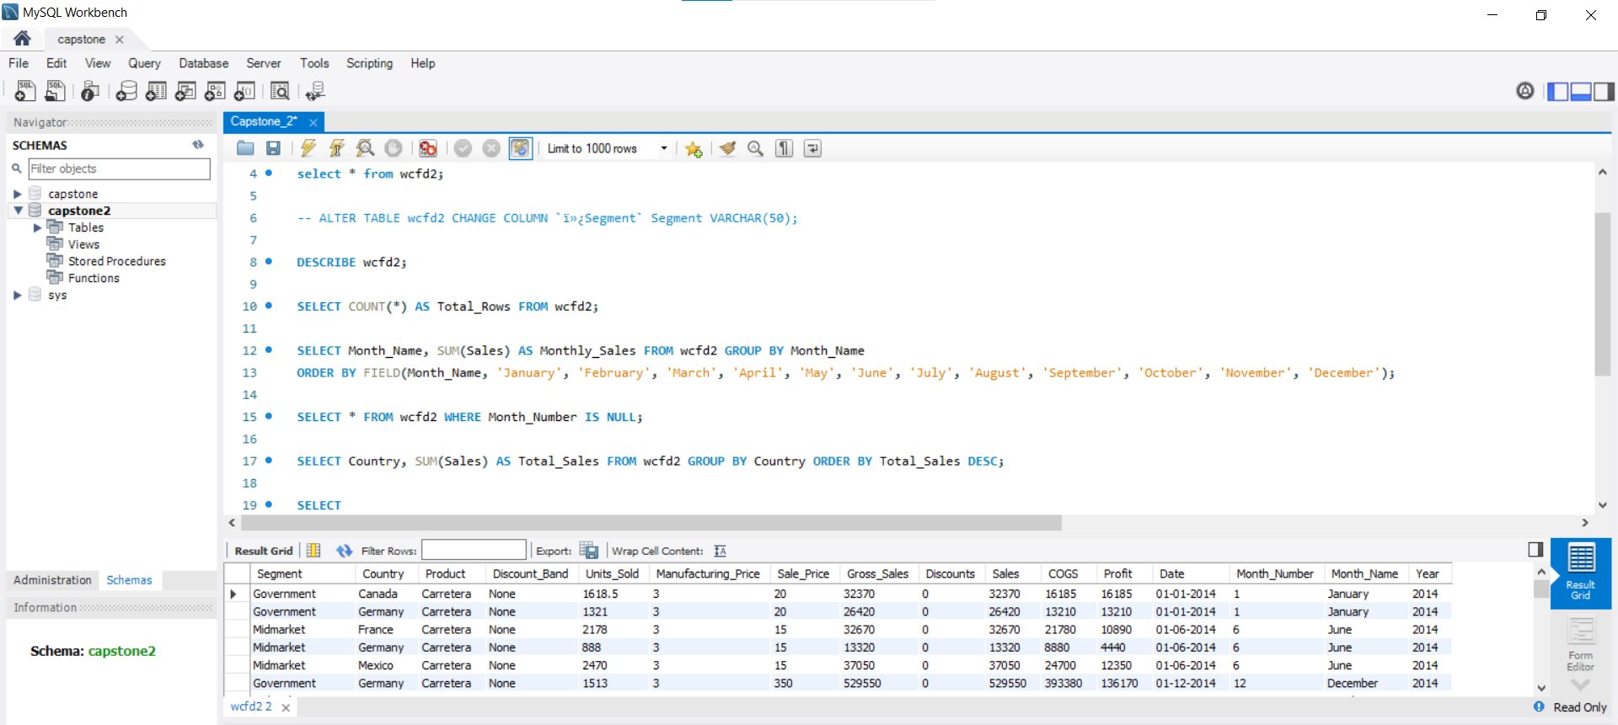
Insert the given data into the SQL server

Slide 7
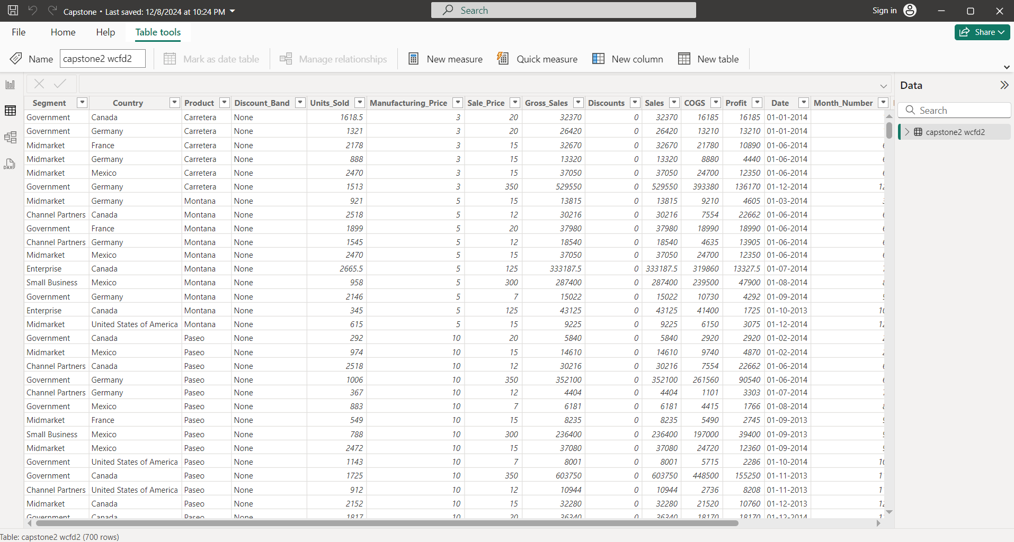
Import the Data from the SQL Database into PowerBI

Slide 8
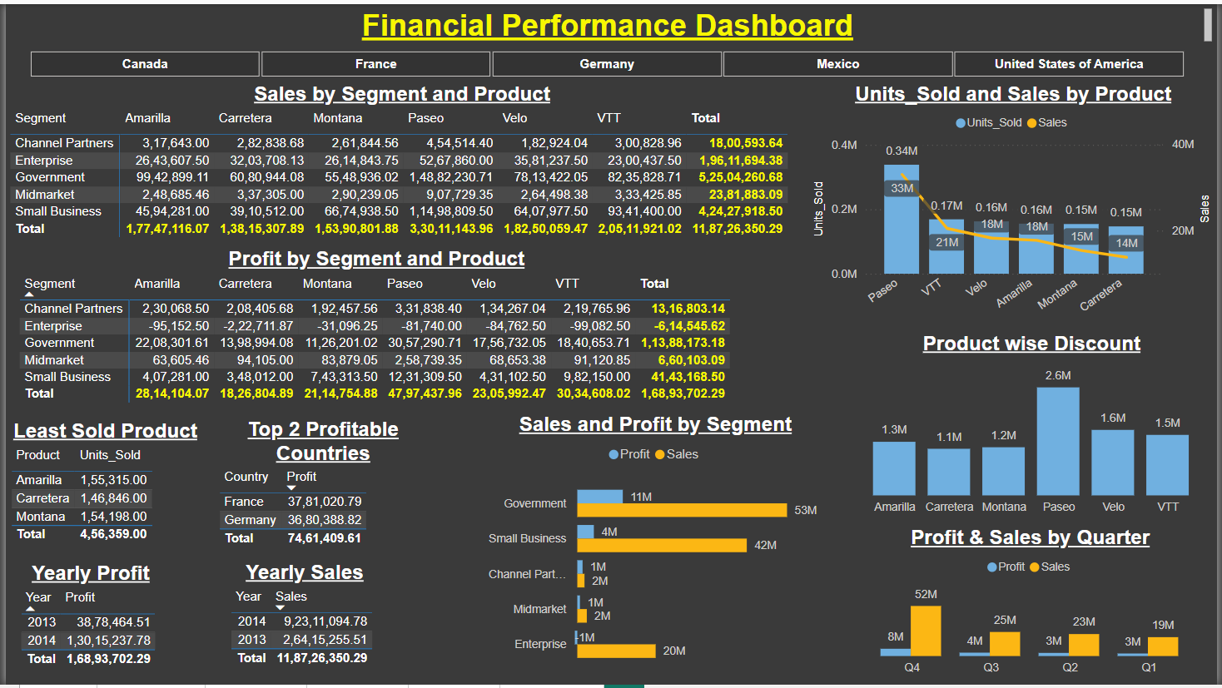
Interactive Dashboard by using visualization tools

Slide 9
Conclusion and Inferences
Highest Sales: Paseo ($33 M)
Lowest Sales: Amarilla ($13.8 M)
Highest Sales: Government ($53M)
Highest Profit: Government ($11M)
Lowest Sales: Channel Partners ($2M)
Lowest Profit: Enterprise ($-1M)
Maximum Discount: Paseo ($2.60 M)
Least Discount: Carretera ($1.12 M)
France & Germany are top 2 profitable countries.
Bottom 3 products based on sales are Amarilla, Montana and Carretera.
Performance in Q4 is better than other Quarter. Point which we have to consider as there are two quarter 4 in the Dataset.
Yearly profit is better for the year 2014.

Slide 10
Endnotes
Links
Western_Countries_Financial_Data:
https://drive.google.com/file/d/1dWOTPx4d-pn2qQ3OkdpB6fCWU9BZW2ub/view?usp=sharing
Capstone Document: https://docs.google.com/document/d/1Yl0AF5mWciTKpORgjWqdKOhS7TfKRRqX/edit?usp=sharing&ouid=103483728038485412461&rtpof=true&sd=true
Capstone Power BI File:
https://drive.google.com/file/d/1y-S_N8OgIOs2Nf2uk-KfhG5fqsJKW6OK/view?usp=sharing
Capstone SQL File: https://drive.google.com/file/d/1TLBQ6E5d00mJsBNI7ZJr6xceDbRHrx_X/view?usp=sharing

